Slide 1
Enterprise Web Development
Full Stack Architecture - Assignment 2
TramoreACApp
Clodagh O’Mara
00965219

Slide 2
Technology Features
Node JS javascript runtime server
Express Server
Mongolab Database and Mongoose library used for communicating with the MongoDB datastore.
API’s integrated Angular JS SPA client app that is integrated with a web API server.
API’s (GET, POST, PUT & DELETE implemented)

Slide 3
Main Features
Home Page (News and useful links)
Profile (Maintain your profile)
Members (Create & Delete Members)
Fixtures (Create & Delete Fixtures)
Blog Posts (Blog articles posted by members related to running, these can be deleted and all associated comments with the post that has been deleted)
Comments – Each blog post has individual comments that can be added or deleted.
Kit Catalogue which is searchable.

Slide 4
Non- Standard Technical Features
Headers and Footers are ‘Include’ pages.
Navigations bars are implemented as ‘Include’ pages.
Used $locationProvider from html5 to simplify the URL’s and remove the #. The angular $locationProvider allowed me to configure how the application deep linking paths are stored.

Slide 5
TramoreAC2 Project Structure
High Level Structure
+ API - Web api/routing scripts folder
+ Config - Express apps configuration scripts folder
+ Node modules
+ Public - Public web resources folder
+ Package.json - application package description file
+ Routes.js
+ Server.js - Base Application Script for my express application

Slide 6
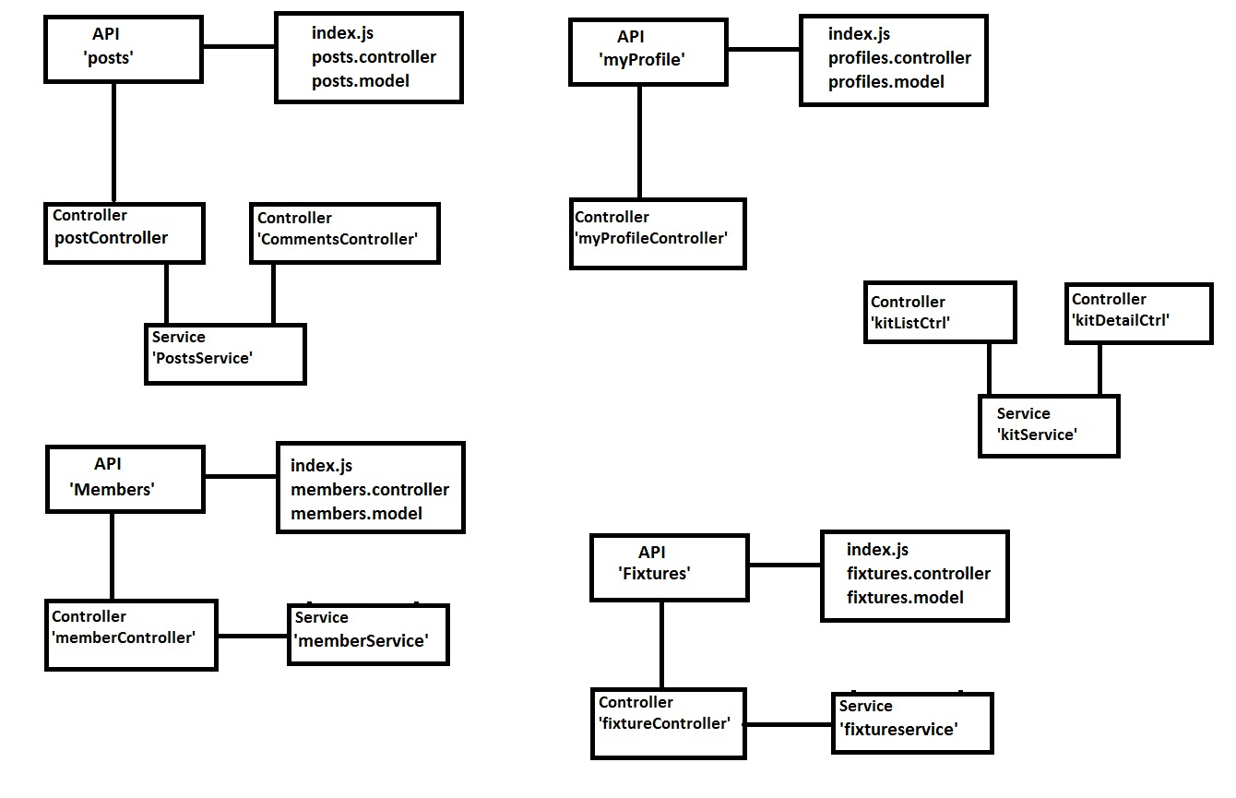
Design Model

Slide 7
API’s Created
API | fixtures | fixtures.controller fixtures.model index.js
 | members | members.controller members.model index.js
 | myprofile | myprofile.controller myprofile.model index.js
 | post | post.controller post.model index.js

Slide 8
Routes created for the Post API
Route | HTTP Verb | Description
/api/post | GET | Get all posts.
/api/post:id | GET | Get a specific post.
/api/post | POST | Create a new unique post.
/api/post:post_id/upvotes | POST | Increase the post upvotes.
/api/post:post_id/comments | POST | Add a comment to a post.
/api/post:post_id/comments/:comment_id/upvotes | POST | Increase the comment upvotes count.
/api/post:post_id | DELETE | Delete a specific post.
/api/post:post_id/comments/:comment_id | DELETE | Delete a specific comment from a post.

Slide 9
Routes created for the Profile API
Route | HTTP Verb | Description
/api/myprofile | GET | Get all the profile details.
/api/myprofile | POST | Update Profile details.
/api/myprofile | PUT | Save edited profile details.

Slide 10
Routes created for the Members API
Route | HTTP Verb | Description
/api/members | GET | Get all the members.
/api/members | POST | Create a member.
/api/members:member_id | GET | Get a single member.
/api/members:member_id | PUT | Update a member with new info.
/api/members:member_id | DELETE | Delete a member.

Slide 11
Routes created for the Fixtures API
Route | HTTP Verb | Description
/api/fixtures | GET | Get all the members.
/api/fixtures | POST | Create a member.
/api/fixtures:member_id | GET | Get a single Fixture.
/api/fixtures:member_id | PUT | Update a Fixture with new info.
/api/fixtures:member_id | DELETE | Delete a member.

Slide 12
Node Modules Used
node_modules | body-parser | Body-parser extracts the entire body portion of an incoming request stream and exposes it on req.body as something easier to interface with.
 | cookie-parser | Parse Cookie header and populate req.cookies with an object keyed by the cookie names.
 | debug | tiny node.js debugging utility modelled after node core's debugging technique.
 | errorhandler | error-handler is a Node.js module for handling server errors in a graceful manner.
 | express | Robust routing HTTP helpers (redirection, caching, etc) Content negotiation Executable for generating applications quickly
 | fs-extra | fs-extra contains methods that aren't included in the vanilla Node.js fs package. Such as mkdir -p, cp -r, and rm -rf.

Slide 13
Node Modules Used
 | graceful-fs | A drop-in replacement for fs, making various improvements. The improvements are meant to normalize behavior across different platforms and environments, and to make filesystem access more resilient to errors.
 | http-errors | Create HTTP errors for Express, Koa, Connect, etc. with ease.
 | lodash | Lodash modular utilities. The Lodash library exported as Node.js modules.
 | mongodb | The official MongoDB driver for Node.js
 | mongoose | Mongoose MongoDB ODM Mongoose is a MongoDB object modeling tool designed to work in an asynchronous environment.
 | morgan | HTTP request logger middleware for node.js
 | quickthumb | QuickThumb is an on the fly, thumbnail creation middleware for express. It utilizes the popular *nix image library, ImageMagick. It allows for the automatic creation of thumbnails by adding query parameters onto a standard image url.
 | shortid | Short ID string generation

Slide 14
Node Modules Used
 | morgan | HTTP request logger middleware for node.js
 | quickthumb | QuickThumb is an on the fly, thumbnail creation middleware for express. It utilizes the popular *nix image library, ImageMagick. It allows for the automatic creation of thumbnails by adding query parameters onto a standard image url.
 | shortid | Short ID string generation

